Slide 2
Geo* Data Science w/
Python
Ian Panganiban

Slide 3
Plan
Lec: 15-20 mins
Hands-on: 50-60 mins
Q&A: 10 mins

Slide 4




Hello, I’m Ian
Prior Engagements with
Currently working
*Head of Cloud Infrastructure
Twitter: @lkpanganiban
Email: lkp@noypimaps.com

Slide 5
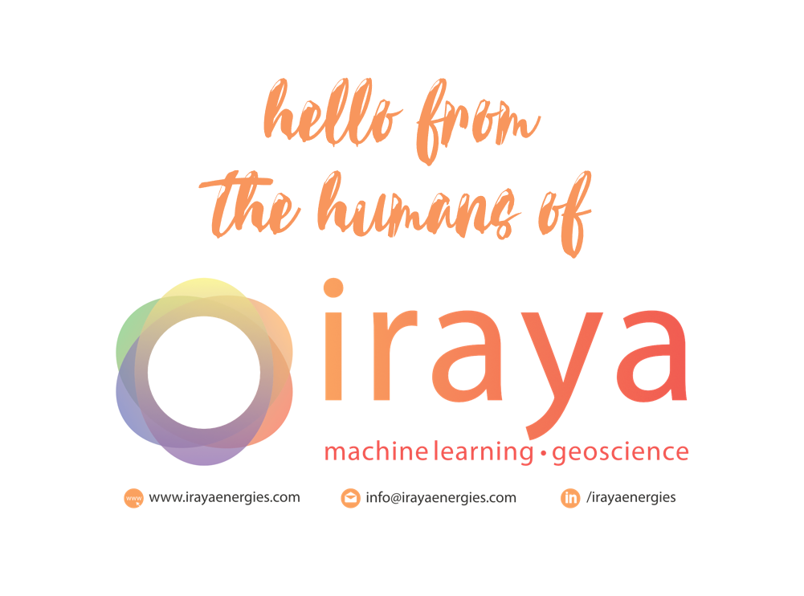

Slide 6

We’re Hiring!!!!!

Slide 7
Outline
Geo* Data Science (GDS)?
GDS Workflow
Python in GDS
Toolsets/Libraries
Wrap Up
Q & A

Slide 8
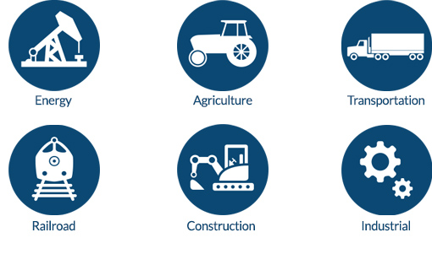
What is Geo* Data Science?
Geospatial
Geoscience
Geodata
Geology
Geography

Slide 9
What is the role of a GDS?
Sometimes creating models and visualization
Sometimes running algos
Most of the time you clean data aka data janitor & data munger

Slide 10
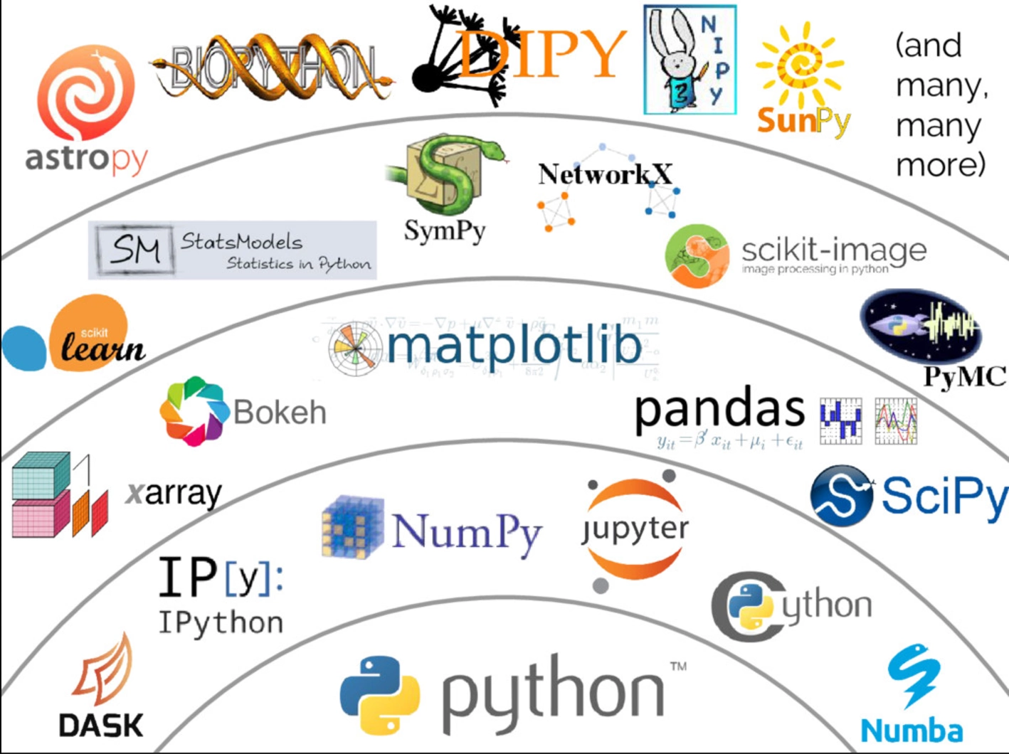
Why Python in GDS?
Notes:
Unified workflow (avoid using multiple tools/systems)
Good for integration with other systems (GIS, web apps, desktop)
A variety of libraries to support proprietary formats
Open Source

Slide 11
GDS Workflow
Hypothesis
Data Acquisition
Data Cleaning & Pre-processing
Processing
Results
Validation & Feedback

Slide 12
GDS Workflow - Hypothesis
What are the problems that you are trying to solve?
Who are your stakeholders/users?
What is the end product?
What is the value of my solution?

Slide 13
GDS Workflow - Data Acquisition
What type of data should I acquire?
What type of data do I have?
Where is my data source? (Database, API, File, Reports, Drones, Survey, Public, Private)
What are the limitations of my data? (spatial resolution, time, sensors, licensing)

Slide 14
GDS Workflow - Data Cleaning/Conditioning
How should I handle null values? (0, N/A, None, Null)
Do I need to apply corrections? (sensor, environmental)
What other pre-processing steps? (rectification, georeference, coordinate consistency, file naming)
This takes around 70% of your time.

Slide 15
GDS Workflow - Processing
What type of algorithm should I use?
Do I need to scale my solution?
Can this be automated?
Do I have enough data?

Slide 16
GDS Workflow - Results
How should I visualize my results? (Maps, Charts, Dashboard)
What are the metrics should I use? (F1-score, precision, std dev, performance benchmarks/runtime)
How should I package my results? (Web app, model, algorithm, workflow)
How should I communicate my results?

Slide 17
GDS Workflow - Validation and Feedback
How should I test my results in the real world?
How do I get user/stakeholder feedback?
How do I monitor my solution? (performance, accuracy)
Is my solution being used?
Notes:
This will dictate if your solutions needs to be recalibrated with new data

Slide 18



Hands-on http://52.187.204.123

Slide 19
Q & A
Notes:
This will dictate if your solutions needs to be recalibrated with new data

Slide 20
References
Awesome Lists
Awesome GIS
Awesome Data Science
Awesome Python
Awesome Geospatial
Repository will be provided later
Notes:
This will dictate if your solutions needs to be recalibrated with new data

Slide 21
Final Note
“The most important part of being a data scientist in general is your skill in identifying and solving problems”
“A great calligrapher doesn’t blame the brush”
"Regardless of what we discover, we understand and truly believe that everyone did the best job they could, given what they knew at the time, their skills and abilities, the resources available, and the situation at hand.“ - Norman Kerth

